Slide 1
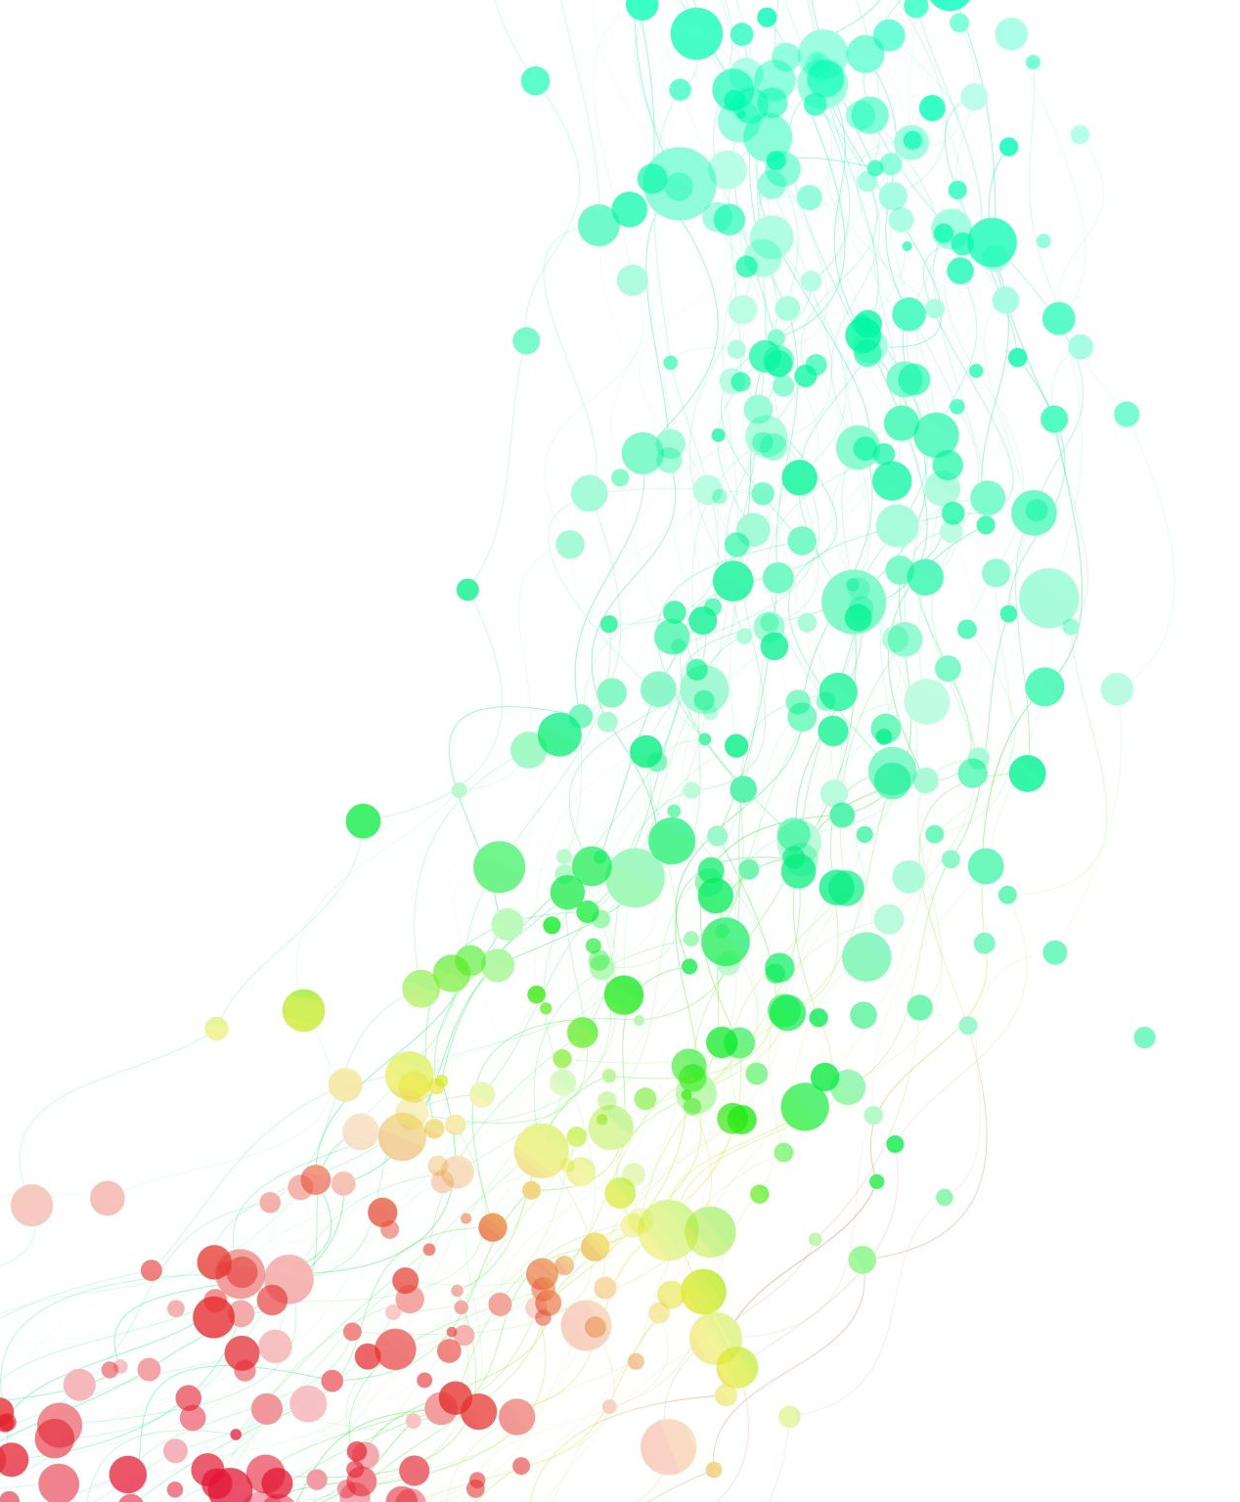
Future Link CSC311 Capstone
Aaron, Benjamin, Antonio, and Bryant

Slide 2

The Team
Aaron
Developer
Project Manager
UX Designer
Database Admin
Ben
Developer
UX Designer
Antonio
Developer
Data Collector
Bryant
Developer
Data Collector

Slide 3


What is Future Link?
Future Link is a one-stop application for future planning for all ages. This includes data on locations, investment strategies, budgeting, and education/career choices. With the data our application can provide, it will provide an easy way for anyone to f gure out the next steps in what they want to with their life moving forward.

Slide 4
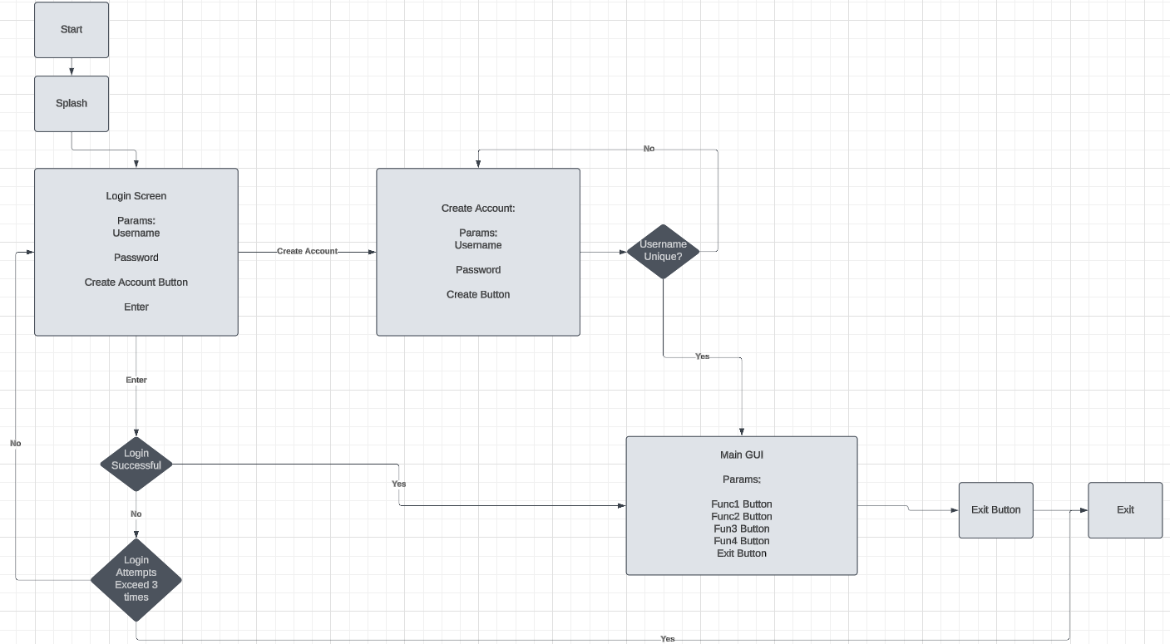
Full Scope Flowchart | Aaron Scott

Slide 5

Investment Strategies
Our application will feature an investment calculator, which will allow users to take how much money they currently have, and how much they plan to invest every month on top of that, to show how much money they would have in ‘x’ amount of years through different investment methods, such as the S&P500, money market, bonds, etc., in addition to showing the pros and cons of doing each, and encouraging a diverse portfolio and additionally showing what that can look like.

Slide 6
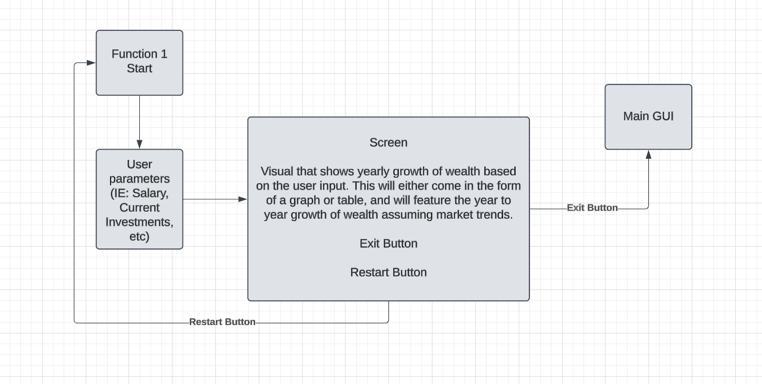
Function 1 Flowchart | Aaron Scott

Slide 7

Locations
Based on a series of prompted questions, including information about your salary, necessities, ideal lifestyle, habits, etc., will show you locations that will better suit your needs. Typically, people are afraid of change because they are afraid of what’s unknown. This function lets the unknown be a little more exposed, so that a user can plan accordingly.

Slide 8
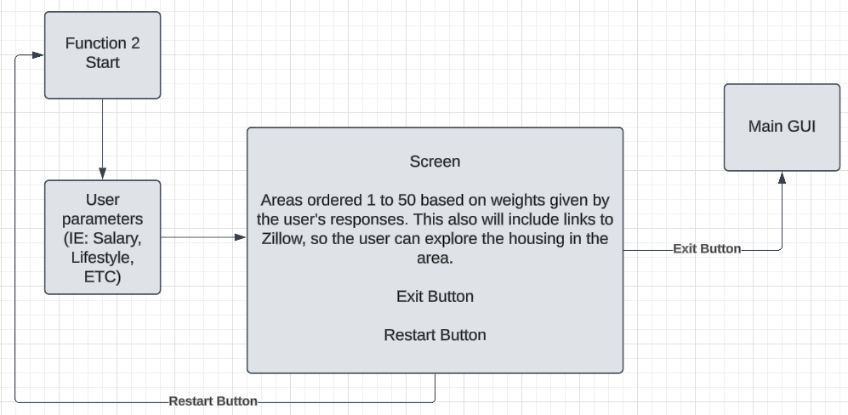
Function 2 Flowchart | Aaron Scott

Slide 9
Education/Career
Our app seeks to provide a guide for the user to lead them to a work environment more suitable to them, to hopefully give them their motivation back from any burnout. This could come in one of 2 outcomes: - A shift in employment paradigm, which has related work field experience requirements, which would allow for a guide to a seamless transition from one workstyle to another. - A realistic complete reset on work/career, and the fastest ways to get back into the workforce in a different field.

Slide 10
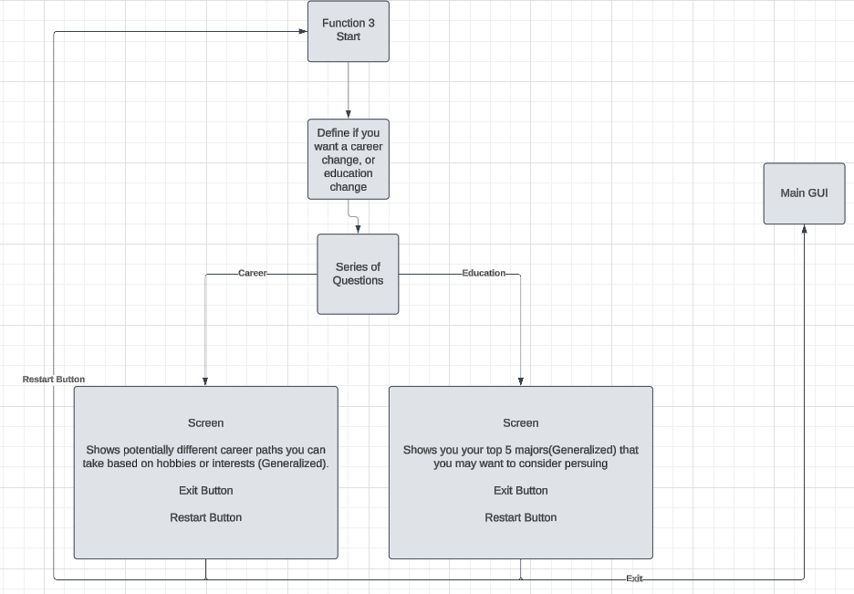
Function 3 Flowchart | Aaron Scott

Slide 11
Budgetting
By taking parameters of user salary, location, household size, estimated taxes(calculated), etc., the application will generate tables of month to month, or week to week budgeting strategies that adapt to the user’s data.

Slide 12
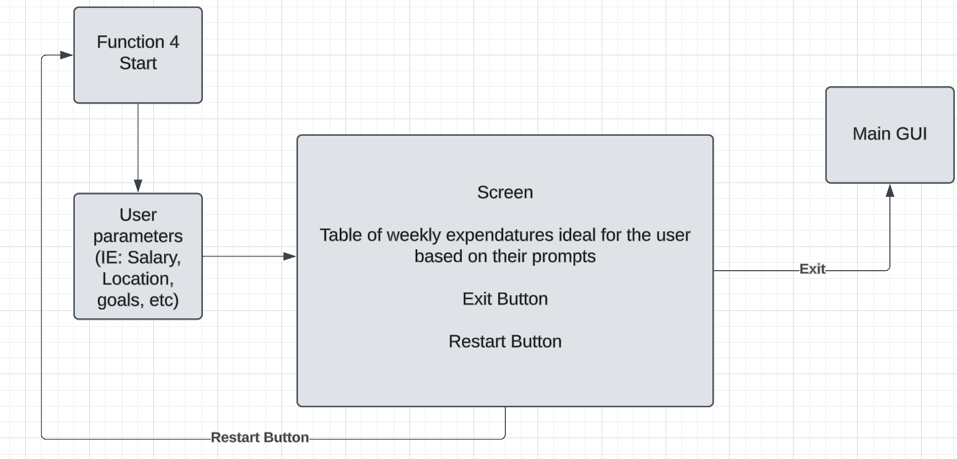
Function 4 Flowchart | Aaron Scott

Slide 13
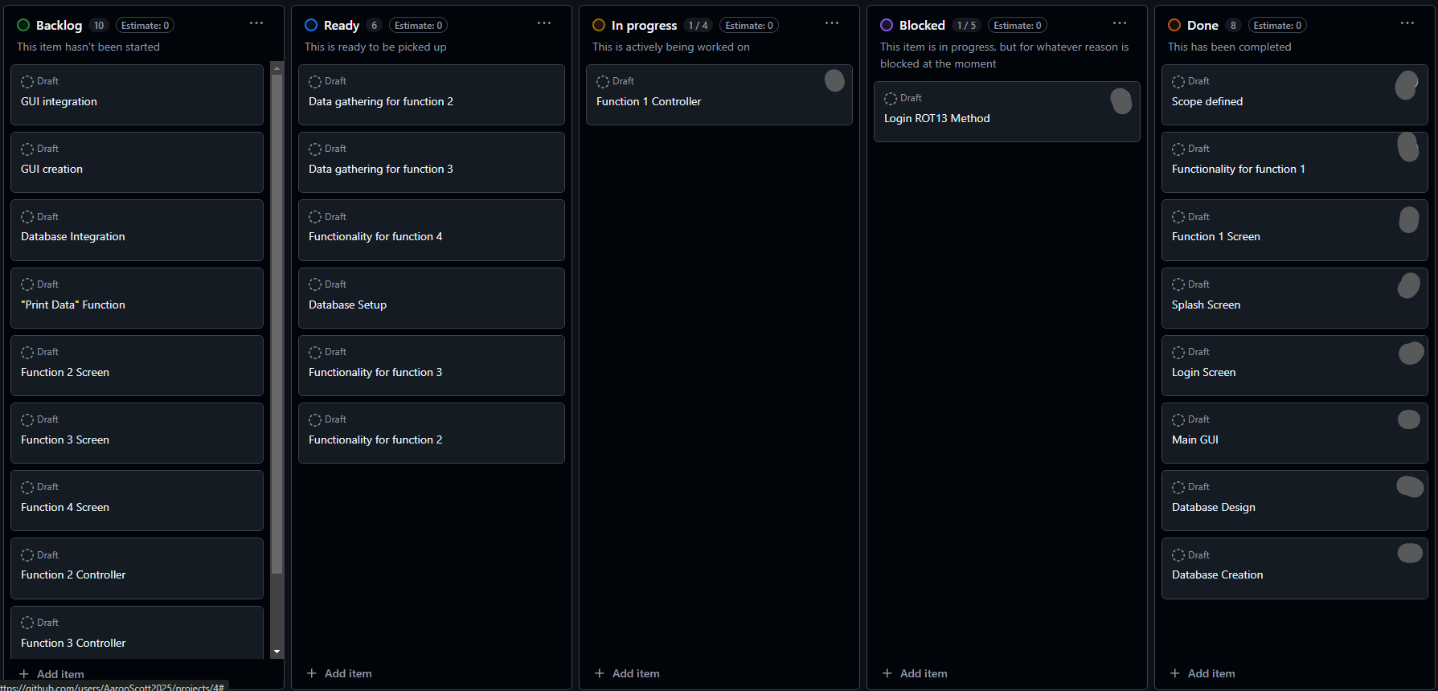
For all progress, we are using a Kanban VIA GitHub to track all progress being made, and who does what. We have behind the scenes, a list of features to be added if time allows for it.

Slide 14
Timeline (From Now)
Week 1: We seek to have half of the functionality + their corresponding GUIs fully implemented.
Week 2: We seek to have the other half of the functionality + their corresponding GUIs fully implemented
Week 3: Finishing touches, styles, and additional unmentioned features worked on.
Week 4: Bug testing, ironing, and review.

Slide 15
Any Questions?

